Slide 1
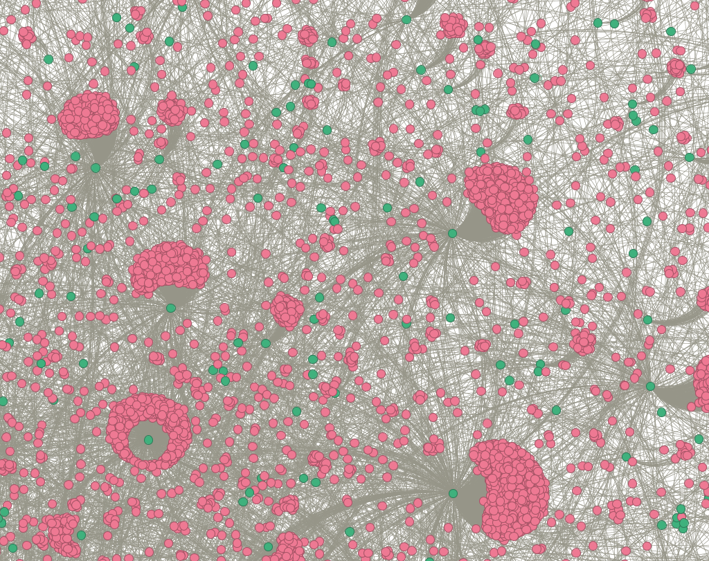
Hypergraph Anomoly Detection
Deven Biehler
Sai Kolagani

Slide 2
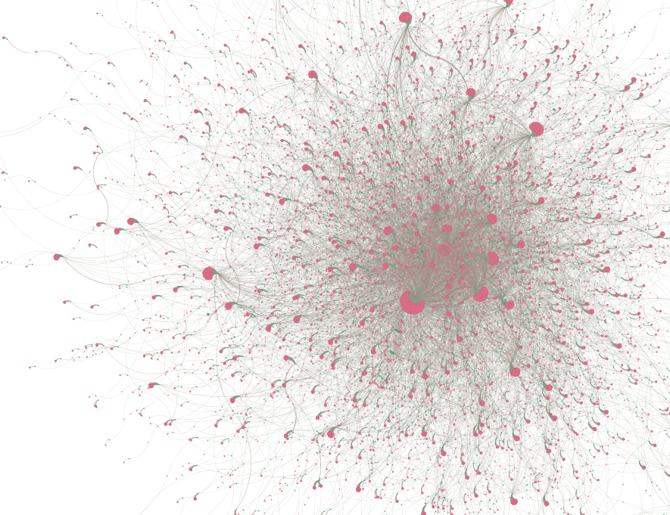
Bipartite Network
Database analyzed was reddit data represented as a bipartite network.
Current tools don’t allow for visualizations for large hypergraphs

Slide 3
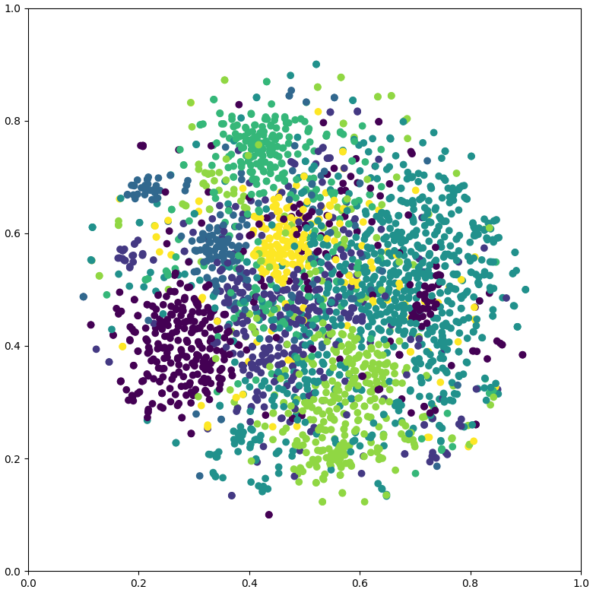
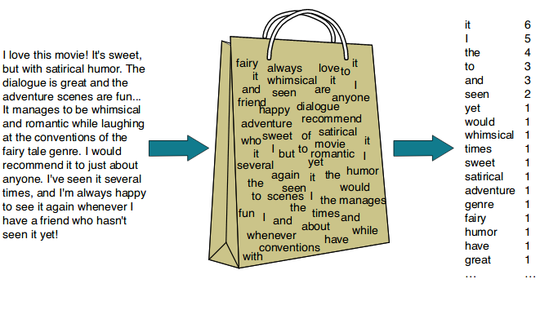
Features
Features were selected using a bag of words vectorization.

Slide 4

PRIMARY GOALS
Annual revenue growth

Slide 5
AREAS OF GROWTH
 | B2B | SUPPLY CHAIN | ROI | E-COMMERCE
Q1 | 4.5 | 2.3 | 1.7 | 5
Q2 | 3.2 | 5.1 | 4.4 | 3
Q3 | 2.1 | 1.7 | 2.5 | 2.8
Q4 | 4.5 | 2.2 | 1.7 | 7

Slide 6
Business opportunities are like buses. There's always another one coming.
Richard Branson

Slide 7





MEET OUR TEAM
TAKUMA HAYASHI
MIRJAM NILSSON
President
Chief Executive Officer
FLORA BERGGREN
RAJESH SANTOSHI
Chief Operations Officer
VP Marketing

Slide 8








The whole team
TAKUMA HAYASHI
MIRJAM NILSSON
FLORA BERGGREN
RAJESH SANTOSHI
President
Chief Executive Officer
Chief Operations Officer
VP Marketing
GRAHAM BARNES
ROWAN MURPHY
ELIZABETH MOORE
ROBIN KLINE
VP Product
SEO Strategist
Product Designer
Content Developer

Slide 9
PLAN FOR PRODUCT LAUNCH
PLANNING
Synergize scalable e-commerce
MARKETING
Disseminate standardized metrics
DESIGN
Coordinate e-business applications
STRATEGY
Foster holistically superior methodologies
LAUNCH
Deploy strategic networks with compelling e-business needs
1
2
3
4
5

Slide 10
TIMELINE
Deploy strategic networks with compelling e-business needs
SEP 20XX
Synergize scalable e-commerce
NOV 20XX
Disseminate standardized metrics
Coordinate e-business applications
MARCH 20XX
Foster holistically superior methodologies
MAY 20XX
JAN 20XX

Slide 11

AREAS OF FOCUS
Develop winning strategies to keep ahead of the competition
Capitalize on low hanging fruit to identify a ballpark value
Visualize customer directed convergence

Slide 12
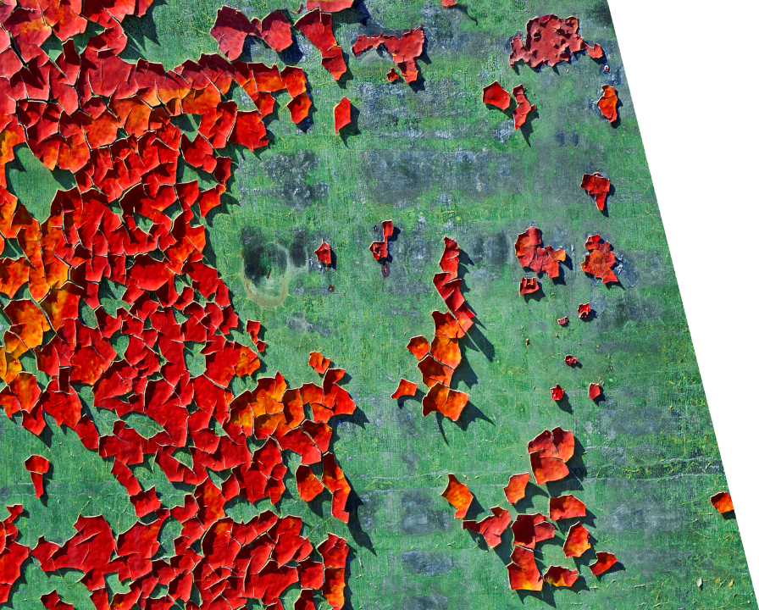
HOW WE GET THERE
ROI
Envision multimedia-based expertise and cross-media growth strategies
Visualize quality intellectual capital
Engage worldwide methodologies with web-enabled technologies
NICHE MARKETS
Pursue scalable customer service through sustainable strategies
Engage top-line web services with cutting-edge deliverables
SUPPLY CHAINS
Cultivate one-to-one customer service with robust ideas
Maximize timely deliverables for real-time schemas

Slide 13

SUMMARY
At Contoso, we believe in giving 110%. By using our next-generation data architecture, we help organizations virtually manage agile workflows. We thrive because of our market knowledge and great team behind our product. As our CEO says, "Efficiencies will come from proactively transforming how we do business."

Slide 14

THANK YOU
Mirjam Nilsson​
mirjam@contoso.com
www.contoso.com

